Slide 1

iLIP – Efficient PR-PO Processing
EQUIPO TRES – Zhi Tao, Jorden, Amalina, Hong Yuan, Anmol, Weikun

Slide 2


Company Introduction
Leading Packaged & Canned food manufacturer in Singapore
95 different products in 9 different categories
Customer base of ~90 wholesale dealers and distributors

Slide 3
Company Introduction
Losing Market share --> Unagile response to urgent orders
Procurement Process is Inefficient & not optimised
Revamp the Purchase Requisition (PR) to Purchase Order (PO) process

Slide 4
Purpose of BPE Team
To interview the stakeholders in the PR-to-PO sub-process
To understand the relationship or involvement that each department has with regards to the whole PR-to-PO sub-process
To perform As-Is Business Process Modelling of the PR-to-PO sub-process
To perform Dynamic Analysis of As-Is process results using simulation and data settings for simulation run

Slide 5
Purpose of BPE Team
Propose recommended initiatives and rationales
Suggest scenarios to tackle bottlenecks or issues in the As-Is process
Formulate the To-Be proposed scenario
Integrating the recommended initiatives
Perform To-Be Business Process Modelling
Based on the PR-to-PO sub-process
Perform Dynamic Analysis of the To-Be Process
Compare results with the As-Is Analysis

Slide 6
Process Redesign Goals
More efficient PR-to-PO sub-process for all departments
Reduce the manual activities
Purchase raw materials/perishables on time
Accurate, reliable and efficient Warehousing process

Slide 7
Process Redesign Goals
Sell finished products to customers as soon as possible
Properly forecast and plan for materials
Reduce the high percentage of maverick buys (one-time agreements)
Efficient and optimal allocation of resources

Slide 8
Management Decision or Policies
‘e-Procurement Service’ and possible online sourcing of products.
Seamless integration
External partners (e.g. suppliers)
Production, procurement and inventory systems
Reduce the need for non-contract buys
Leverage on inventory management technologies

Slide 9
Management Decision or Policies
Manage manufacturing’s expenditures
Analysing cost information
Product categories
Non-contracted items
Ensure that suppliers are delivering quality products.
Fast response to demand / production hiccups
Outsourcing processes (e.g Warehousing Process)

Slide 10
Performance Targets
Process Performance Targets | Metrics
1.To increase overall efficiency by reducing the process duration for the PR-to-PO sub-process by at least 50% | Weighted average duration for each individual path
2. To reduce the overall cost of a PR-to-PO sub-process by at least 50% | Weighted average cost of PR-to-PO request for each individual path
3. Remove identified bottlenecks | Number of bottlenecks and the delays caused by each of them
4, Reduce manual activities | Number of manual activities

Slide 11
Static Analysis: As-Is
Main Issue Identified
Several manual activities → Inefficient
PA has to decipher the handwritten hardcopy purchase requisition form
Manually input the requested item into the PWS
Manually search for one-time agreement suppliers
PB has to manually check for hardcopy contracts
Root Causes
Paper-based system
Lack of system integration

Slide 12
Dynamic Analysis: As-Is
Path Analysis
8 different paths with 2 different end points
Estimated weighted average duration: 2557.76 mins (42 hrs 38 mins)
Estimated weighted average cost: $171.96
Most Occurring Path - Path 1
Existing contracts meet the required delivery date
Stock availability check tallies
Distribution of 48%
Average duration: 2774 minutes over 5 days
Average cost: $174.38

Slide 13
Dynamic Analysis: As-Is
Path Analysis
8 different paths with 2 different end points
Estimated weighted average duration: 2557.76 mins (42 hrs 38 mins)
Estimated weighted average cost: $171.96
Most Occurring Path - Path 2
Existing contracts meet the required delivery
Stock availability check does not tally
Distribution of 32%
Average duration: 1991 minutes over 5 days
Average cost: $139.74

Slide 14

Dynamic Analysis: As-Is
Bottleneck Analysis
Procurement Admin
Sourcing for new suppliers (12 d, 13:27 h)
Manually keying in the requested items (28 d, 12:46 h)
Finance Clerk
Login to PWS to Tally item costs, Commit budget in FIS (22 d, 09:30 h)
Professional Buyer
Final review, creating and printing the PO for PR in PWS (6 d, 14:05 h)

Slide 15
Recommended Initiatives & Rationale
5 Initiatives
Removal of Paper-based system
Integrate LIS, PWS, FIS
Removal/Delegation of redundant roles(e.g. MRPC/FC)
Outsource Warehouse process
Early Stock Availability Check

Slide 16
iLIP
Integrated Logistics, Inventory & Procurement

Slide 17
Recommended Initiatives & Rationale
Initiative 1 - New Centralised IT System
Easily accessible by people from different departments
Eliminate need to look for hard copy contracts
Improved readability of PR form

Slide 18
Recommended Initiatives & Rationale
Initiative 2 - Integration of PWS, LIS & FIS
Reliable, integrated and updated data for all departments
Facilitates automatic retrieval of data
Real-time updating to existing systems.

Slide 19

Recommended Initiatives & Rationale
Initiative 3 – Removal/Delegation of Redundant Roles (MRPC/FC)
Automate MRPC activities to save costs
Delegate FC’s roles to PA to manage manufacturing expenditures
FC also causes bottleneck of 535 minutes in PR-PO process
Lower PA costs means more resources, thus reducing bottleneck
Role | Responsibility | Cost
MRPC | Email & Validation | $55/hr
FC | Tally item costs, Commit Budget | $45/hr

Slide 20
Recommended Initiatives & Rationale
Initiative 4 - Outsource Warehouse process
Warehouse Inventory System(WIS) is difficult to use
Has limited functionalities
High-level vision of the Management
Outsource the Warehouse Process.

Slide 21
Recommended Initiatives & Rationale
Initiative 5 - Check Stock availability before checking for contracts
Late stock availability check → Lengthy process
If stock does not tally, a new sub-process has to be triggered.
Time and cost wastage
Can be mitigated through early rejection if stock is unavailable

Slide 22
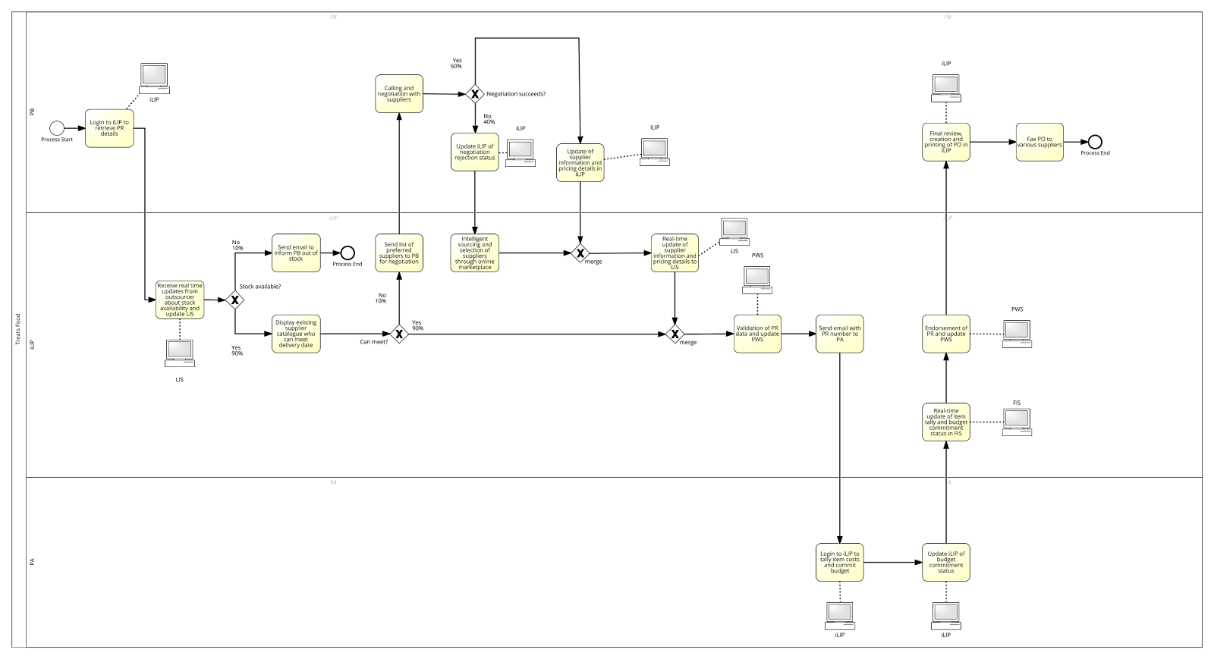
To-Be Business Process Scenario

Slide 23
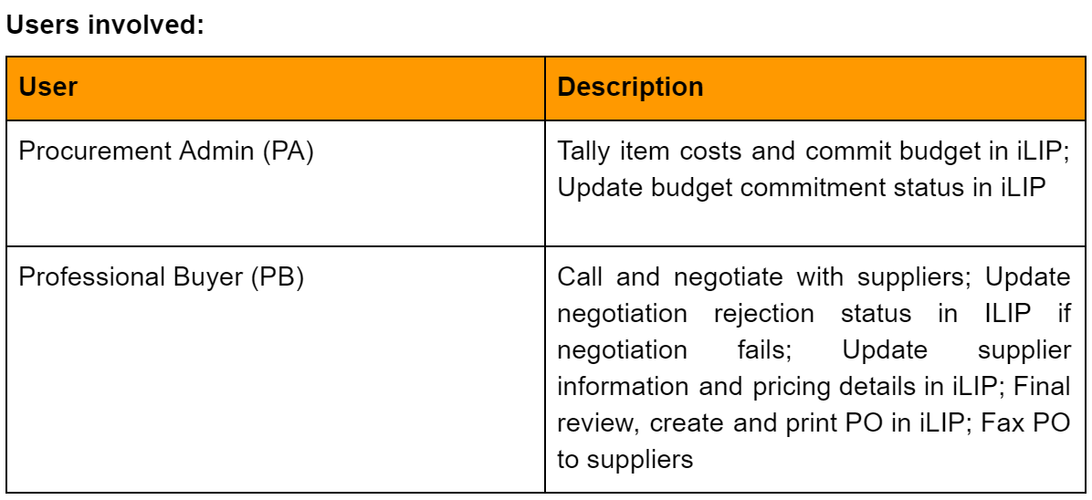
Users & IT

Slide 24
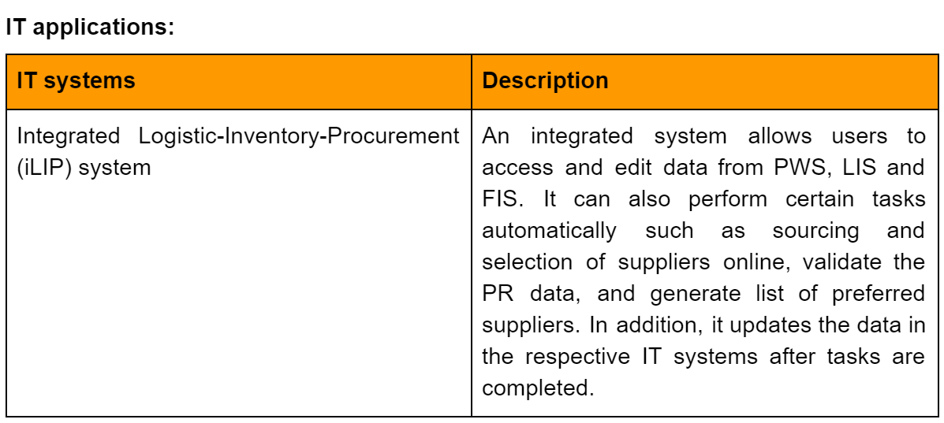
Users & IT

Slide 25
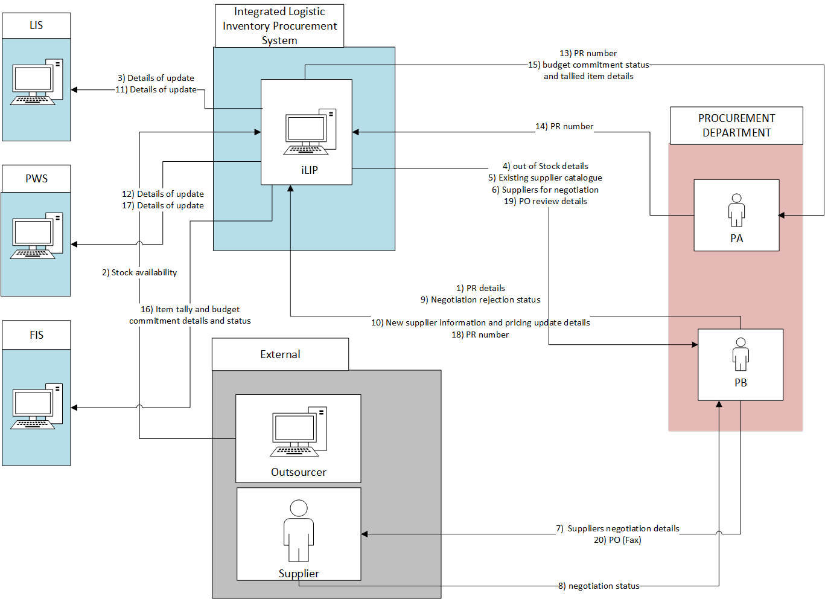
To-Be Collaboration Model

Slide 26
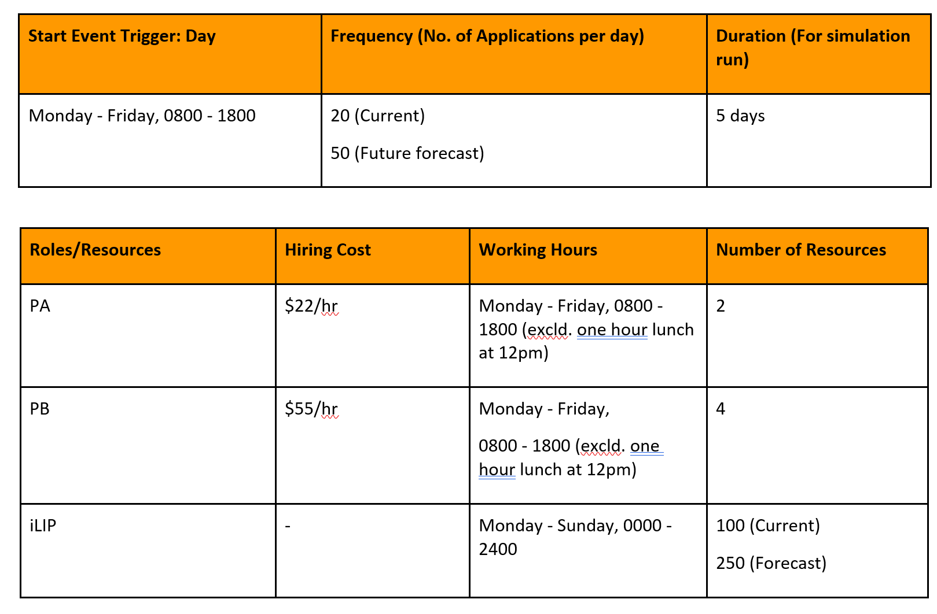
Data Settings

Slide 27
Dynamic Analysis: To-Be Business Process
Path Analysis
Per Purchase request:
4 different paths with 2 different end points
Weighted average duration --> 53.378 mins
Weighted average cost -->$37.35

Slide 28
Dynamic Analysis: To-Be Business Process
Most Occurring Path (81%)
Available stock & Existing contracts can meet the indicated delivery date
Average Cost → $37.35
Average Time taken → 61 minutes

Slide 29
Dynamic Analysis: To-Be Business Process
Bottleneck Analysis
No Bottlenecks
All Bottlenecks in As-Is model eliminated
No Time and Cost Wastage
Efficient usage of resources

Slide 30
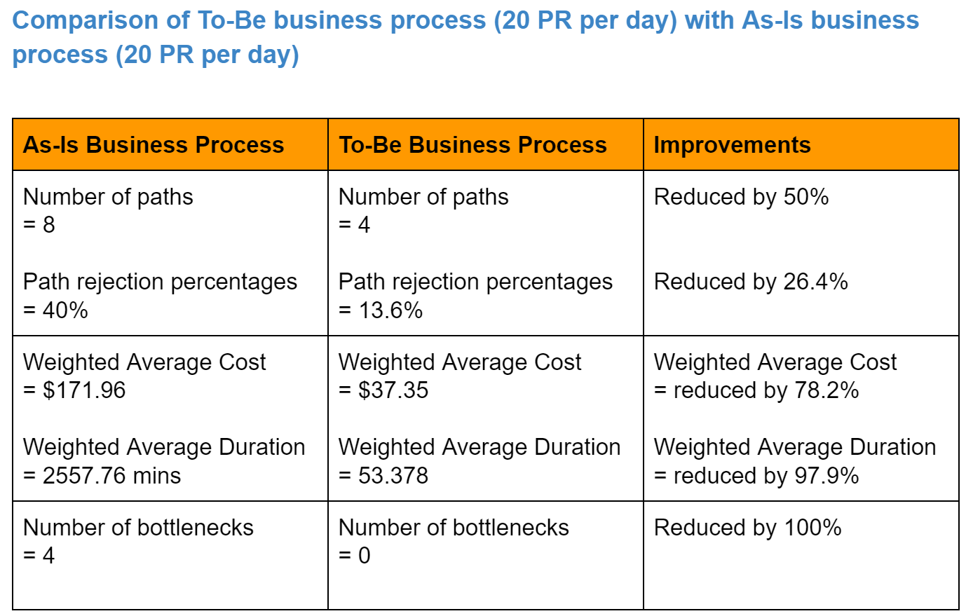
As-Is Process VS To-Be Process

Slide 31
Demand Forecast Analysis
Future Demand Analysis of To-Be business process (50 PR per day)
Weighted average cost remained the same
No bottlenecks were present
iLIP is a sustainable model that can meet future demands easily

Slide 32
Concept Solution
Blueprint Models

Slide 33
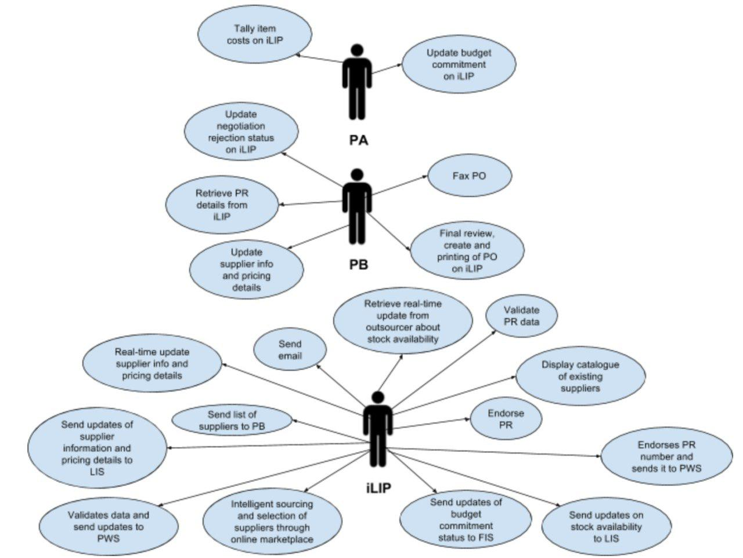
Use Case Diagram

Slide 34
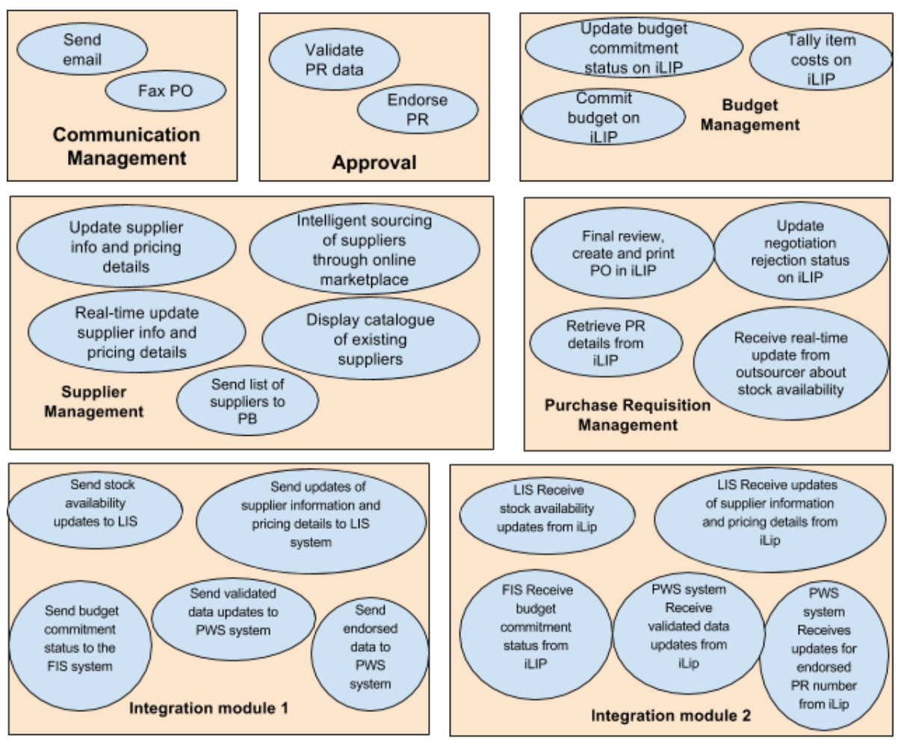
Use Case to Function

Slide 35
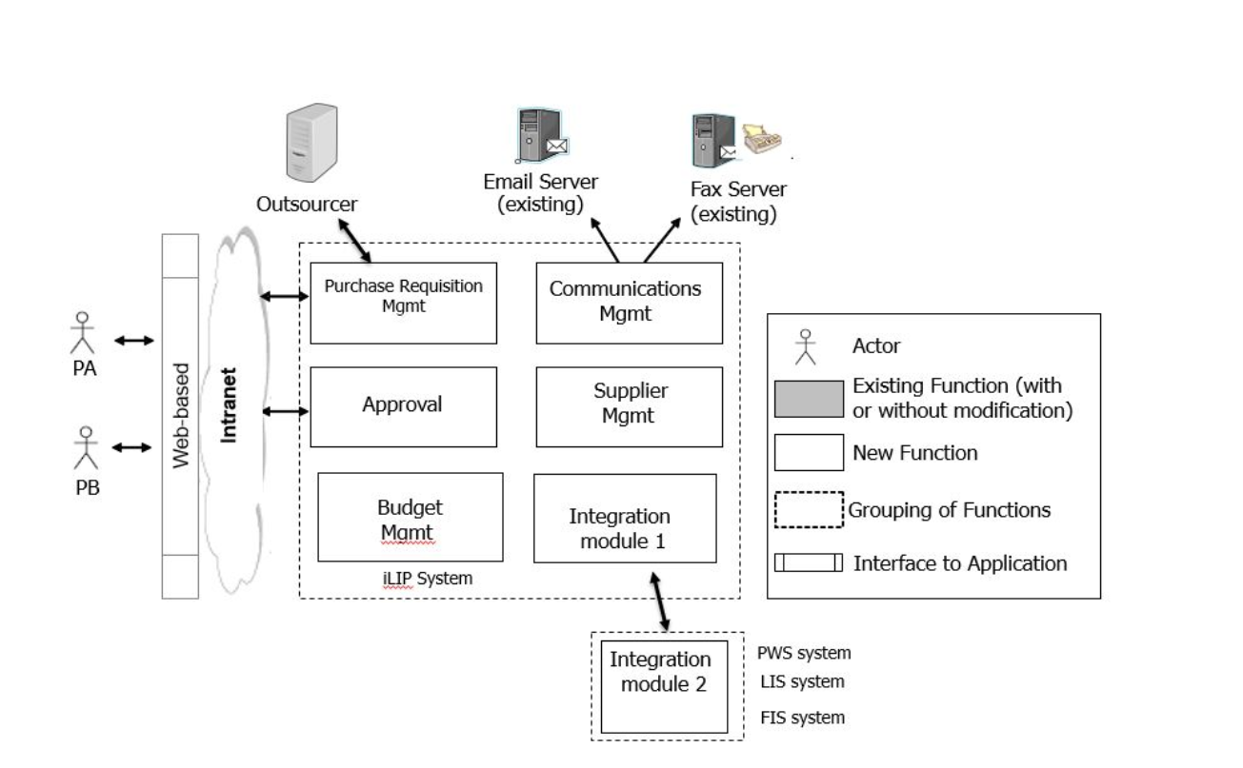
Solution Overview Model

Slide 36
Functional Model
Function | Use Case | New/ Existing/ To be Modified
PR Request Management | Receive real-time update from outsourcer about stock availability Update negotiation rejection status in iLIP Retrieve PR details from iLIP Create and print PO in iLIP | New

Slide 37
Functional Model
Function | Use Case | New/Existing/To be Modified
Approval | Validate PR data in iLIP Endorse PR in iLIP | New
Communications Management | Send email Send fax | New

Slide 38
Functional Model
Function | Use Case | New/Existing/To be Modified
Budget Management | Tally items costs in iLIP Commit budget in iLIP Update budget commitment status in iLIP | New

Slide 39
Functional Model
Function | Use Case | New/Existing/To be Modified
Supplier Management | Update supplier information and pricing details Real-time update supplier information and pricing details Intelligent sourcing and selection of suppliers through online marketplace Send list of suppliers to PB | New

Slide 40
Functional Model
Function | Use Case | New/Existing/To be Modified
Integration module 1 | iLIP system send updates of stock availability check to the LIS system iLIP system send updates of supplier information and pricing details to the LIS system iLIP system validates data and send updates to the PWS system. iLIP system send updates of the budget commitment status to the FIS system. iLIP system endorses PR number and send endorsed PR number to the PWS system | New

Slide 41
Functional Model
Function | Use Case | New/Existing/To be Modified
Integration module 2 | LIS system gets updates from the of stock availability from the iLIP system LIS system gets updates of the supplier information and pricing details from the iLIP system PWS system get updates of validated data from the iLIP system FIS system gets the updates of the budget commitment status from the iLIP system PWS system gets the updated PR number from the iLIP system. | New

Slide 42
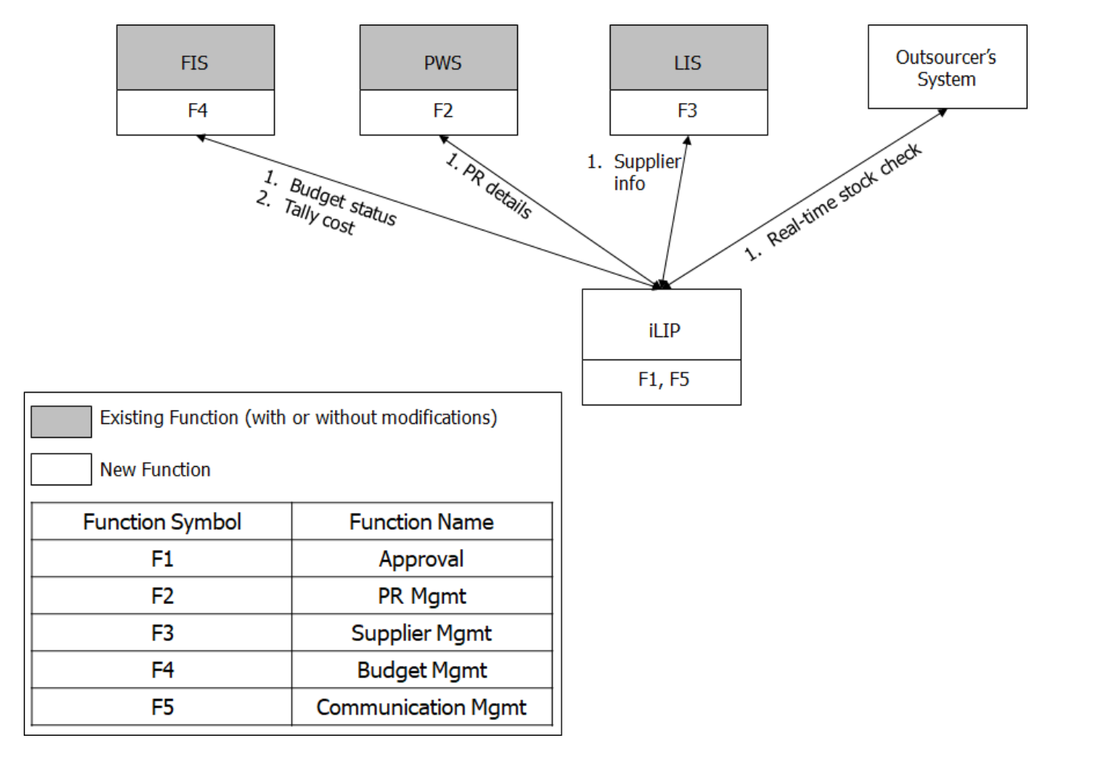
Application Model

Slide 43
Data Analytics
Application

Slide 44
Data Analytics Application: To-Be Process
Business Challenges
What is the success rate for negotiation with suppliers?
What is the predicted wait time for the “Intelligent sourcing of suppliers through online marketplace” task?
Efficiency of real-time updates provided by outsourcer for stock availability
Time taken for data migration of PWS, LIS and FIS → iLIP
What is the predicted wait time for creation and printing of PO in iLIP?

Slide 45
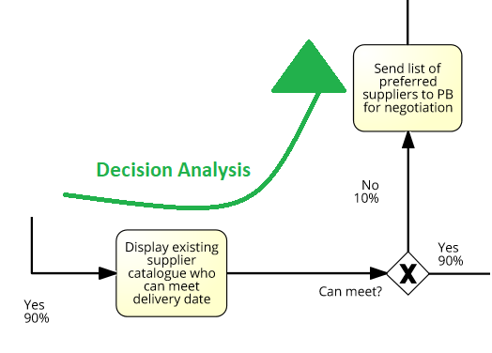
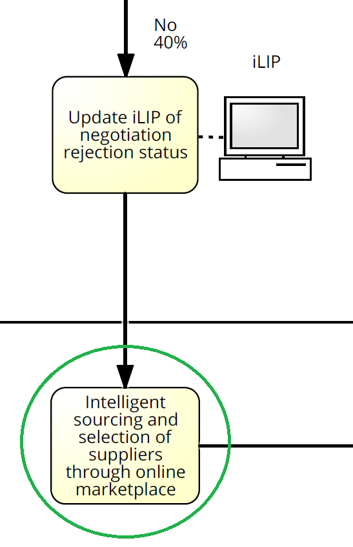
Data Analytics Application: To-Be Process
How is Data Analytics applied
Decision Analysis of preferred suppliers in existing catalogue
Intelligent Sourcing & Selection of new suppliers

Slide 46


Data Analytics Application: To-Be Process
Data required
Activity | Data Attributes
Receive real time updates from outsourcer about stock availability | Real Time Stock Update Id, Stock Availability status
Intelligent Sourcing for new suppliers | Supplier Id, Purchase Order ID, Recommendation Percentage
Update of supplier information and pricing details in iLIP | Supplier Id, Pricing Details
Actor | Data Attribute
Procurement Admin | Employee ID, Employee name, Birthdate, Age, Gender
Professional Buyer | Employee ID, Employee name, Birthdate, Age, Gender
Integrated Logistic Inventory Procurement (iLIP) system | Stock availability status, Email ID, Supplier ID, Delivery Date, Purchase Requisition ID
Supplementary data | Data Attributes
Outsourcer | Name of Company, Real Time Stock Availability Status, Length of Contract
Purchase Order | Purchase Order ID, Date, Item description, Quantity, Price, Supplier name, Shipping details, Billing details

Slide 47
Data Analytics Application: To-Be Process
Statistical Measures
No. | Statistical Measures
1 | Stock Availability rate
2 | Number of suppliers provided by intelligent sourcing
3 | Average number of updates from outsourcer per day
4 | Ratio of successful negotiations to unsuccessful negotiations
5 | Number of suppliers that can meet delivery date
6 | Number of preferred suppliers
7 | Average Intelligent sourcing turnaround
8 | Percentage of PRs endorsed
9 | Number of item costs tallied and budget committed
10 | Average final review, creation and printing of PO time

Slide 48
Data Analytics Application: To-Be Process
Analytics Questions
Analytic Questions | Analytics Type
What is the average time taken to tally costs and commit budget by PA? | Descriptive
What is the average wait time for real time stock availability updates? | Descriptive
What is the % of successful negotiations | Descriptive
What is the average final review, creation and printing of PO in iLIP turnaround? | Descriptive
What is the predicted % of contracts which can meet delivery date? | Predictive
What is the predicted % success rate for negotiations with suppliers? | Predictive

Slide 49
Data Analytics Application: To-Be Process
Analytics Questions
Analytic Questions | Analytics Type
What is the predicted contract pricing details? | Predictive
What is the predicted average wait time for endorsement of PR | Predictive
How often should data migration occur to ensure smooth integration of existing systems with iLIP | Recommendation
Advices on contract pricing for suppliers? | Recommendation
Which is the recommended new supplier to deal with? | Recommendation
Advices on time and cost efficiency of outsourcer? | Recommendation
Notes:
What is the predicted contract pricing details?
(Because details is priced to be for highest success rate. If price is too high, intelligent sourcing will not recommend them as supplier)

Slide 50
Proposed Justification & Conclusion
Number of paths → Dropped from 8 to 4
Reduction in path rejection rate from 40% to 13.6%
Manual activities eliminated with introduction of Automated Tasks
All bottlenecks have also been eliminated
Weighted average cost and duration have been reduced
78.2% and 97.9% respectively
Notes:
What is the predicted contract pricing details?
(Because details is priced to be for highest success rate. If price is too high, intelligent sourcing will not recommend them as supplier)

Slide 51
Proposed Justification & Conclusion
Process Performance Targets | To-be Process Redesign Performance
1.To increase overall efficiency by reducing the process duration for the PR-to-PO sub-process by at least 50% | 1. Overall efficiency improved as process duration for PR-to-PO sub-process reduced by 97.9%
2. To reduce the overall cost of a PR-to-PO sub-process by at least 50% | 2. Overall cost of PR-to-PO sub-process reduced by 78.2%
3. Remove identified bottlenecks | 3. All bottlenecks removed
4, Reduce manual activities | 4. All manual activities removed
Notes:
What is the predicted contract pricing details?
(Because details is priced to be for highest success rate. If price is too high, intelligent sourcing will not recommend them as supplier)

Slide 52
Mucho Gracias
Socorro Socorro

